Slide 1


GENERATIVE AND PREDICTIVE AI FOR IMPROVED INDUSTRIAL PROCESSES
Presented by
ARYAMAN SINGH DEV
(200929064)
In partial fulfilment of requirements for the award of the degree of
BACHELOR OF TECHNOLOGY in MECHATRONICS ENGINEERING
AT
SymphonyAI
(15/01/2024 – 30/06/2024)

Slide 2

Table of contents
Introduction to Organization
Present Day Scenario
Project outcomes
Problem Definition
Results and Conclusion
Plan of Action for Next Term

Slide 3
Introduction TO THE ORGANISATION
Build leading AI software solutions for businesses to help customers accelerate revenue growth and improve productivity with predictive and generative AI.
Various verticals include
Retail
Financial Services
Industrial
Media
Enterprise IT
Trading and Investing

Slide 4
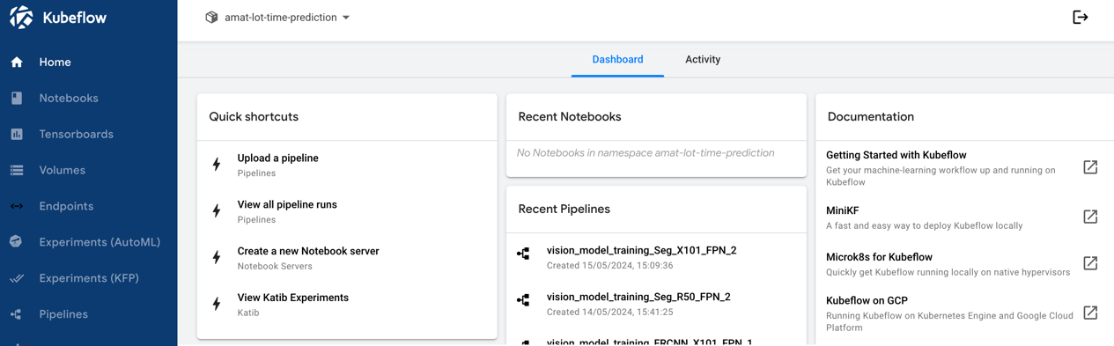
PRESENT DAY SCENARIO
Energy and Refining tenant dashboards perform personalised predictive dashboard solutions for client-specific data.
The IRIS (Industry Reasoning and insights Service) Workspace confidently makes data-driven decisions in the form of time-series analysis and visualized analysis.
MLOps (Machine learning Operations) and industrial copilots predict and detect issues in performance.
BHP IRIS platform
ADE (Anomaly Detection Engine) is used to detect anomalies.
Fig 1- Kubeflow for code confidentiality

Slide 5
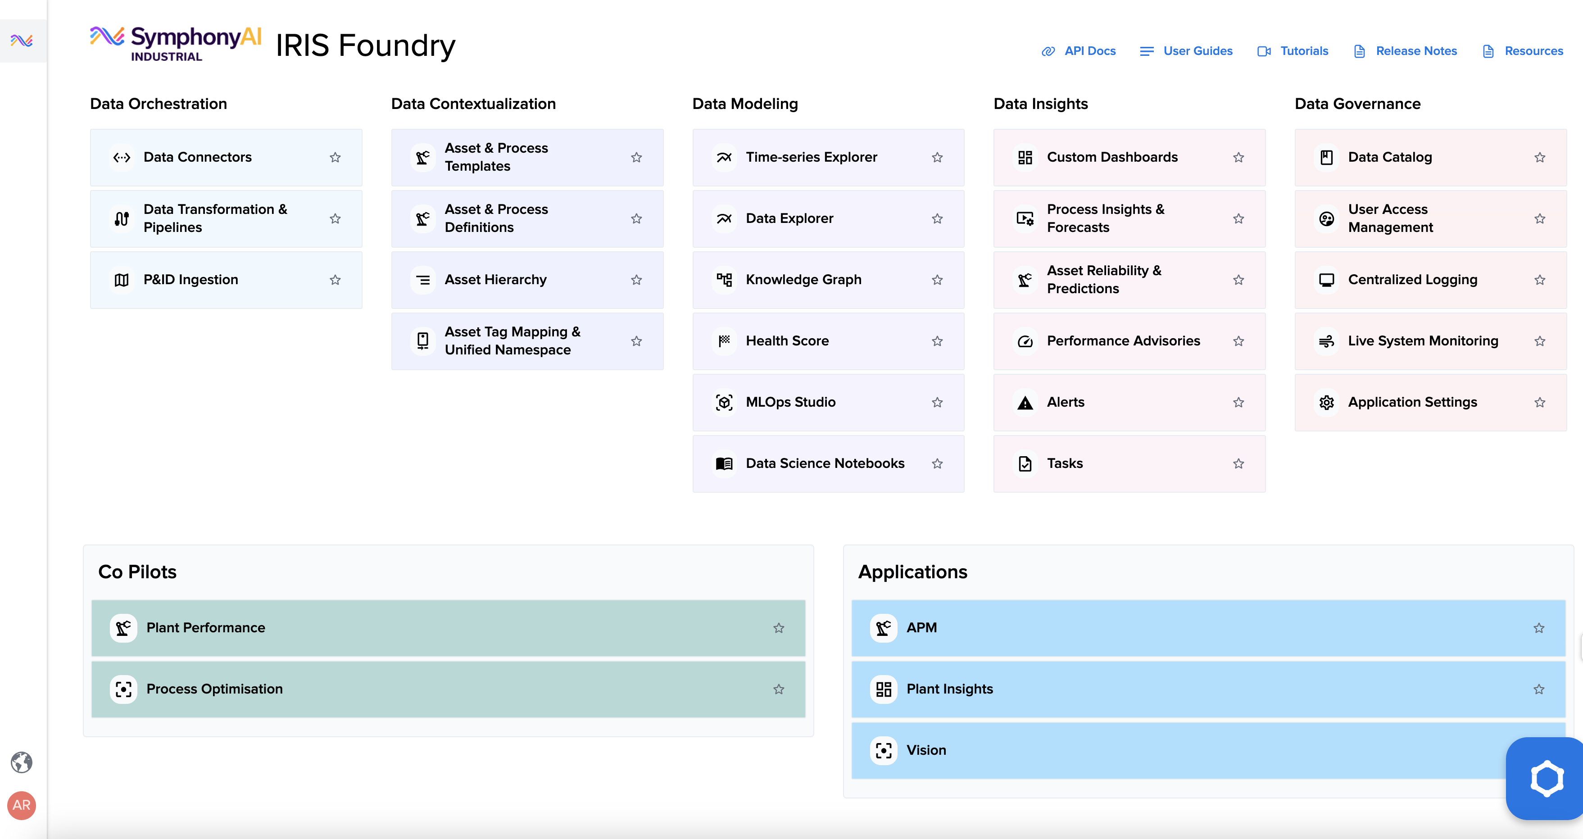
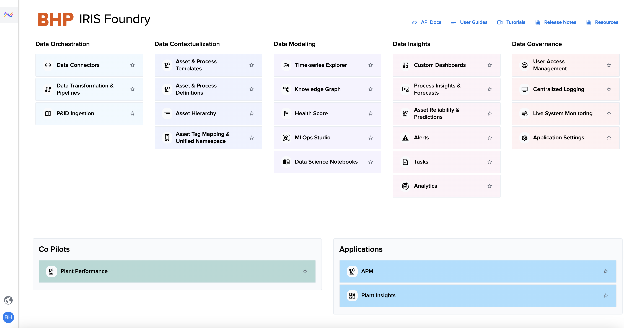
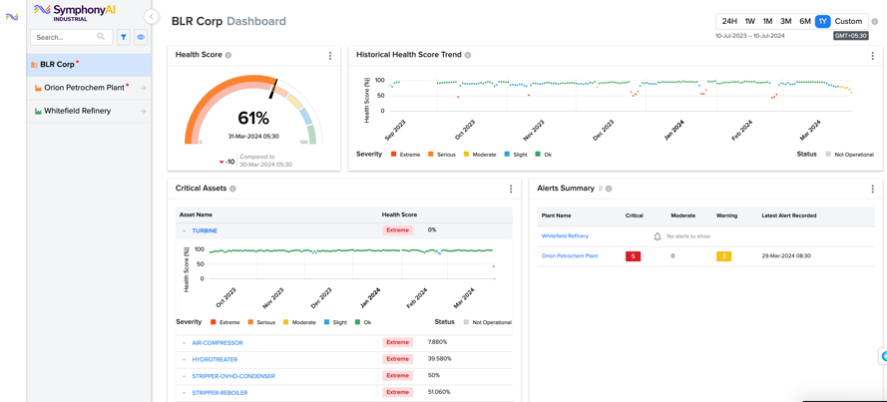
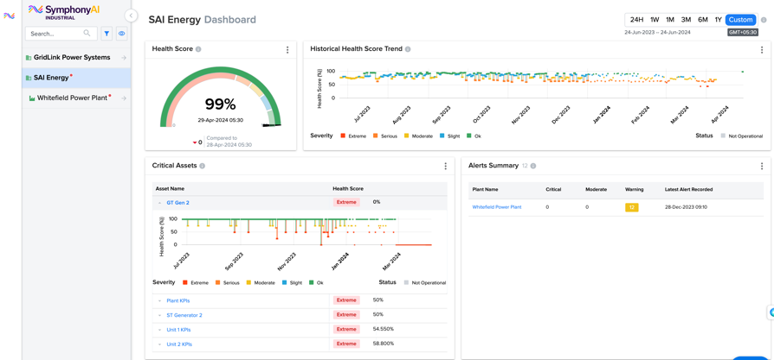
PRESENT DAY SCENARIO
Fig 2- IRIS Foundry platform
Fig 3- BHP IRIS Foundry platform
Fig 4- Refining tenant dashboard
Fig 5- Energy tenant dashboard

Slide 6
PROJECT OUTCOMES
TDK machine data-
Worked on the individual machine data for the 5 machines.
The aim focused on comparing the variables across different datasets and provide statistical insights.
Centrifugal data-
Arise the need for anomaly detection techniques to improvise the cost and reduce wastes in machinery.
UR data-
Worked with the UR problem and evaluated the problem points by targeting specific variables requiring customer issues.

Slide 7
PROBLEM DEFINITION
MANUALLY FIND ERRORS AND MISCLASSIFICATIONS IN THE P&ID DIAGRAMS
FIND ERRORS AND ANOMALIES IN INDUSTRIAL PROBLEMS

Slide 8
OBJECTIVES
Understand and implement Piping and Instrumentation Diagrams (P&ID) for the tenants, and manually document the errors and misclassifications in P&ID diagram before testing the P&ID ingestor software
Optimize manufacturing operations and improve efficiency through real-time insights and anomaly detection for various tenants by using the platforms of IRIS Workbench, Kubeflow and DTS AI Studio
Integrate the data files with the application using Postman API (Application Programming Interface) to communicate data between the platform and the web application

Slide 9
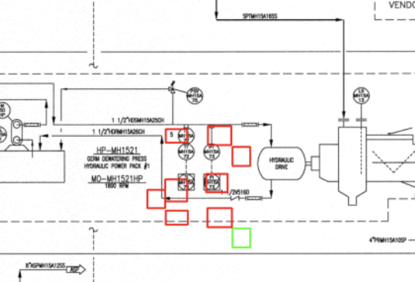
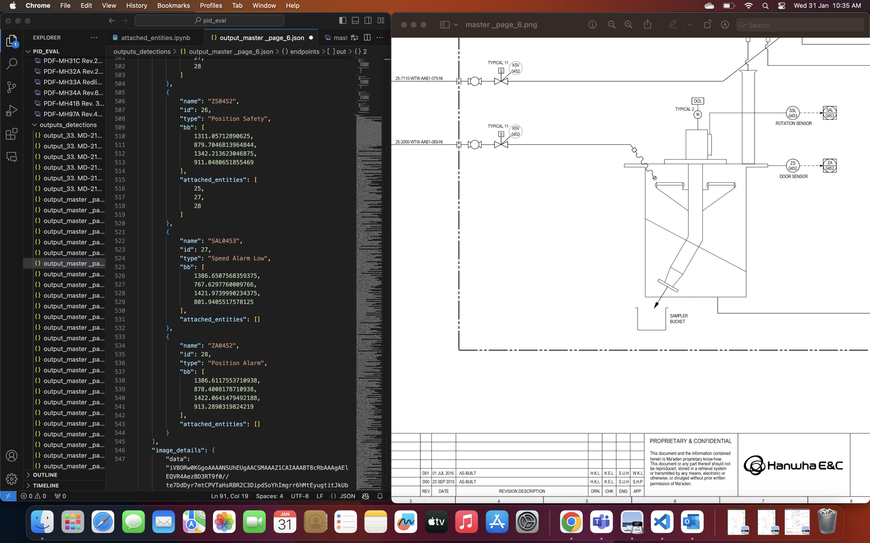
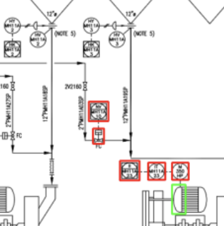
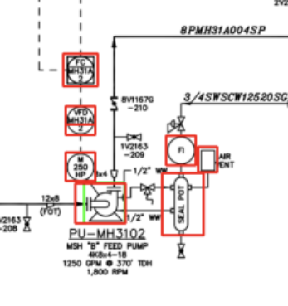
methodology
Fig 8 - errors
Fig 6-JSON file correction
Fig 7 – errors
Inspect each JSON file to identify and document errors in name, ID number, bounding box (BB) values, or type of assets, tags and endpoints.
Find errors in BB manually by testing
Fig 9 - errors

Slide 10
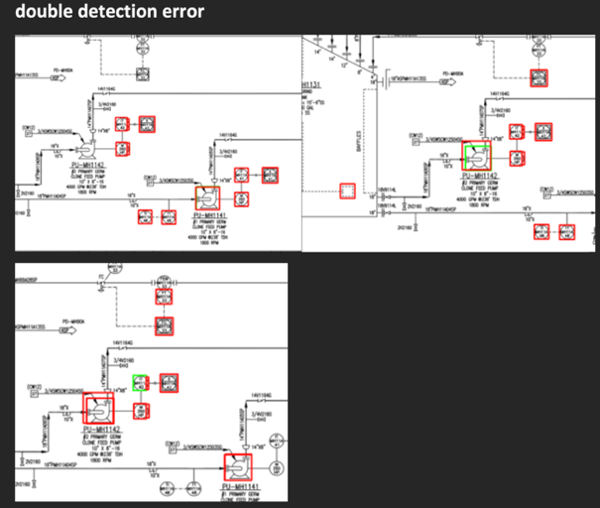
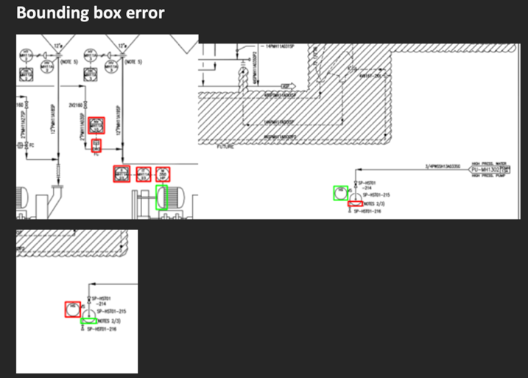
methodology
Fig 10 – documenting errors
Fig 11 – documenting errors
Created detailed documentation of each identified error for further analysis and correction in code.
Corrected the errors and generated new JSON files with improved accuracy.

Slide 11
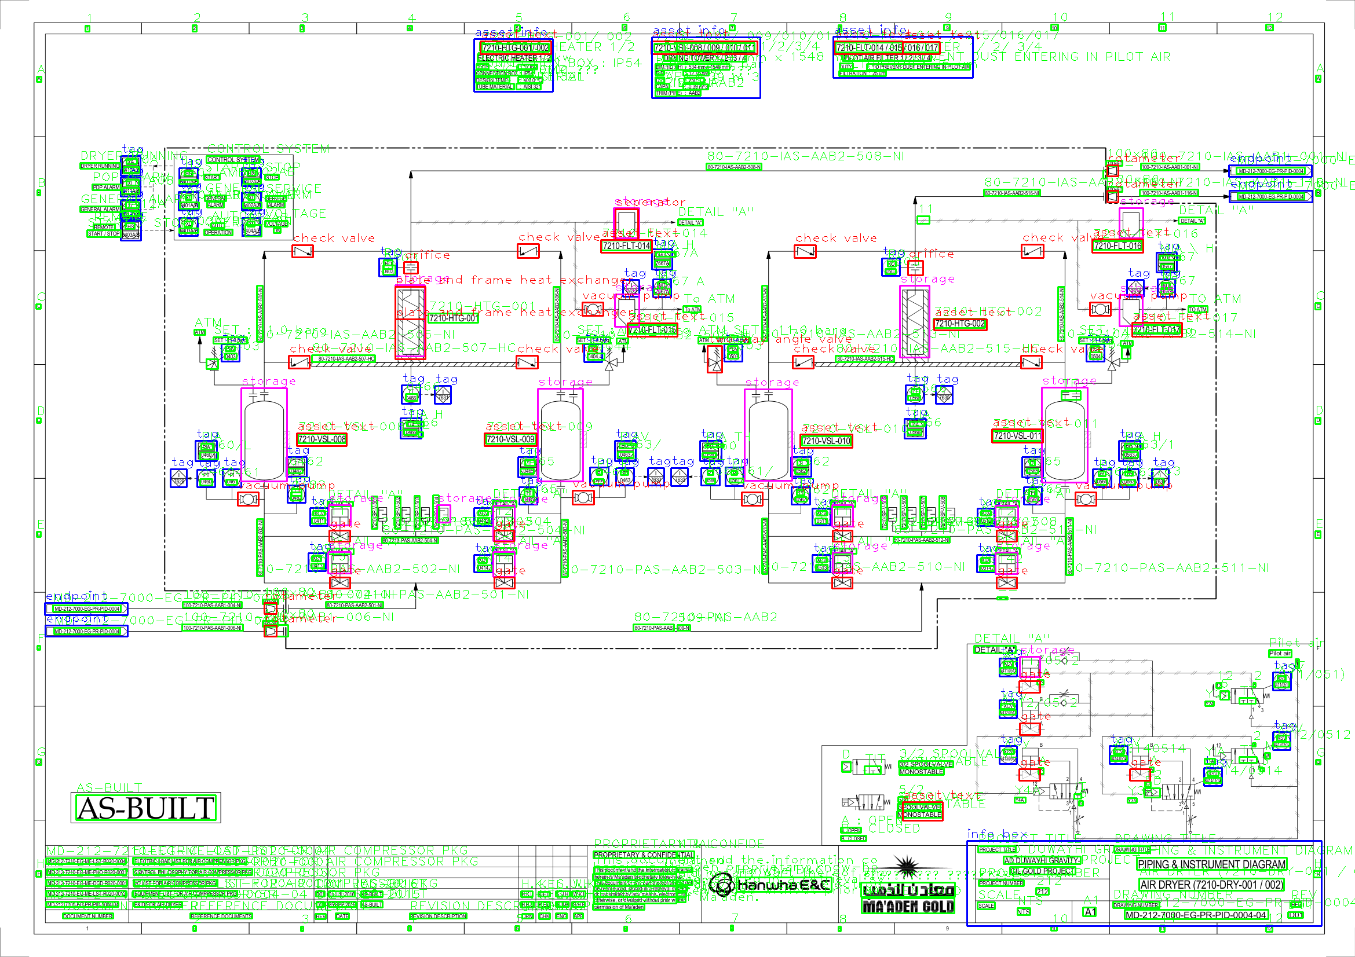
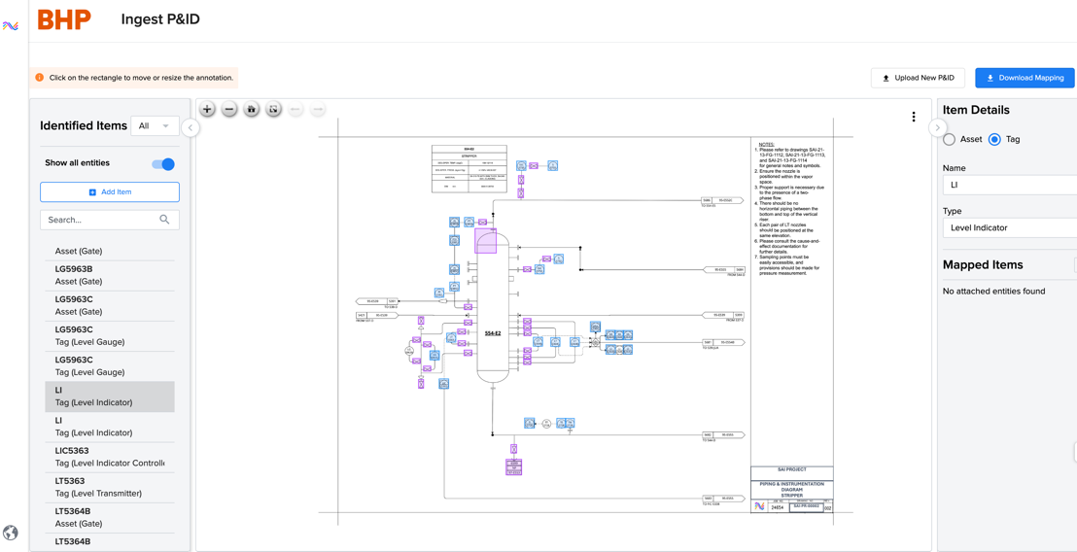
methodology
Fig 12 – BHP IRIS P&ID ingestor
Fig 13 – IRIS Foundry P&ID ingestor
Test the P&ID ingestor after documenting the errors and differences between actual and predicted BB, and name.

Slide 12
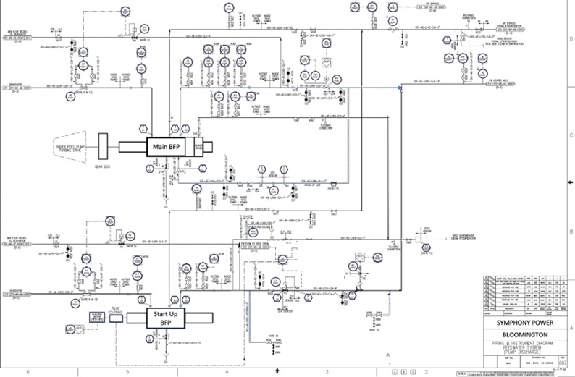
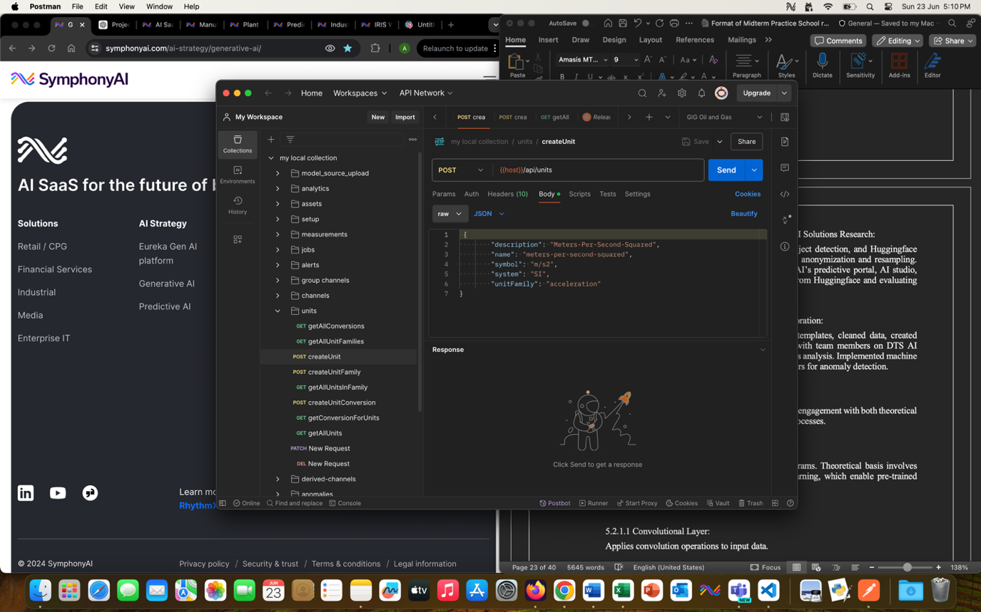
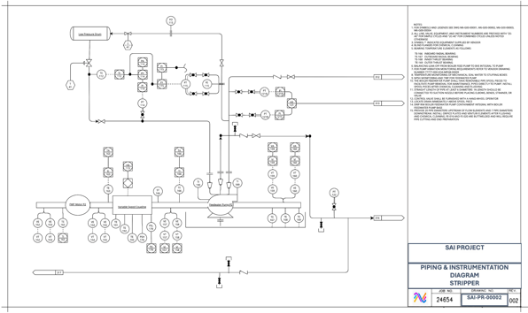
methodology
Fig 14 – P&ID created for Energy and Petrochemical tenants
Fig 15 – Applied Postman testing between tenant dashboards and data presented
Use Visual Paradigm software to generate P&ID diagrams for Energy and Petrochemical tenants.
Research about units, tags and endpoints in P&ID diagram.
Perform Postman testing using GET, POST, DELETE actions.
Test personalized dashboards.

Slide 13
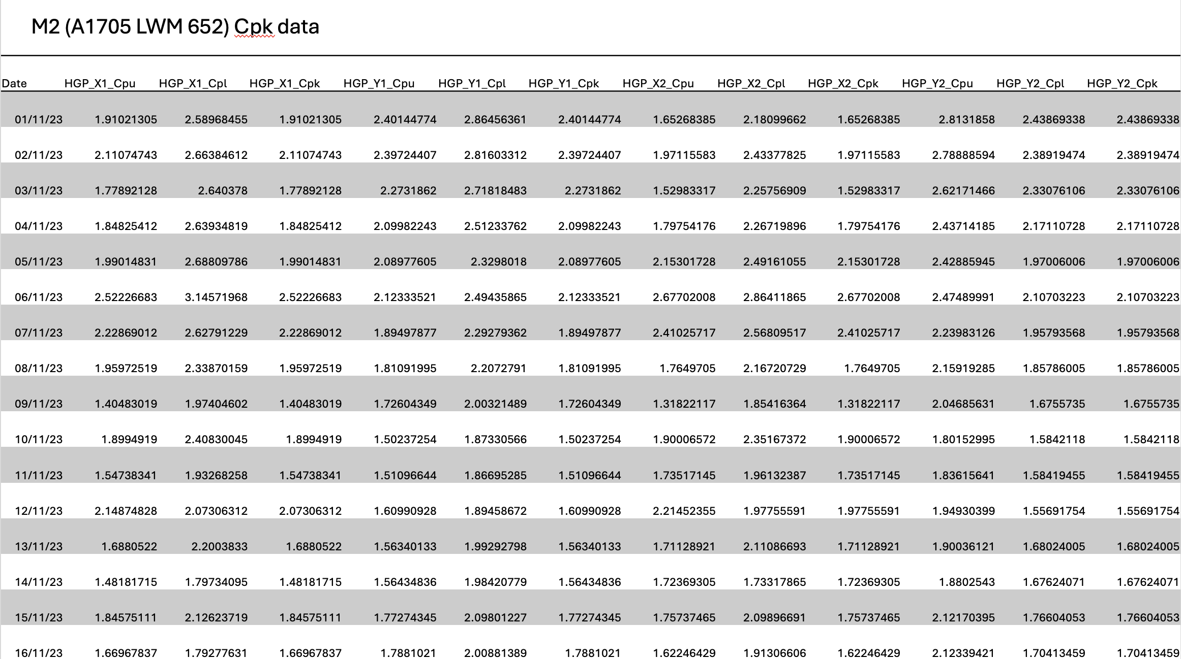
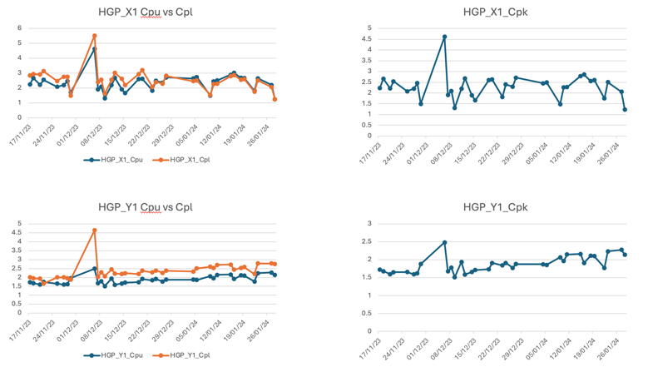
Methodology - TDK use case
Fig 17 – Visualization of machine data for variables
Fig 16 – Machine data for all variables
Calculated Cpl (lower limit), Cpu (upper limit) to find trend in Cpk (lower value between Cpl and Cpu)
Performed general data pre-processing like resampling, removed duplicates and dropped NaNs.
Outlier Removal using IQR (Inter-Quartile Range) to identify and remove outliers. Generally, outliers are defined as data points that lie outside 1.5 times the IQR below the 1st quartile (Q1) and above the 3rd quartile (Q3)

Slide 14
Methodology - TDK use case
Merge and clean the data within LCL and UCL
Drop NaNs
Replace 555 and 9999 values with 0 and mean value
Knn imputation to clean data with neighbors 5 and 10
Extract date for time series analysis
Remove outliers
Draw UCL and LCL lines
Outlier percentage

Slide 15
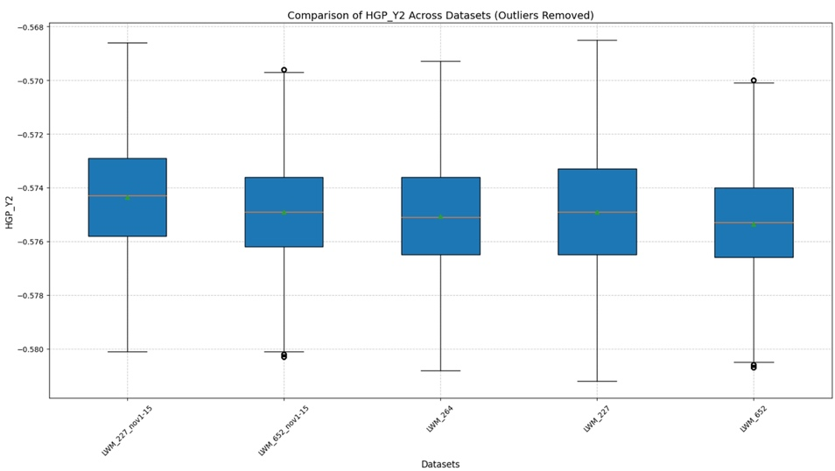
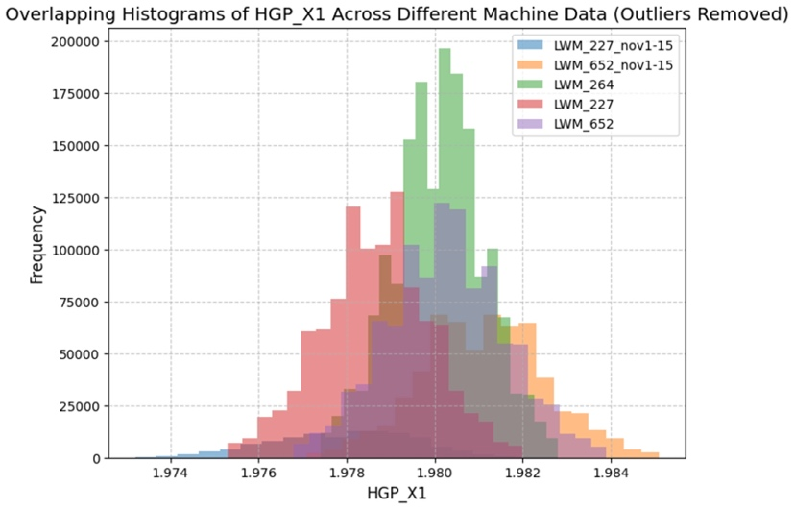
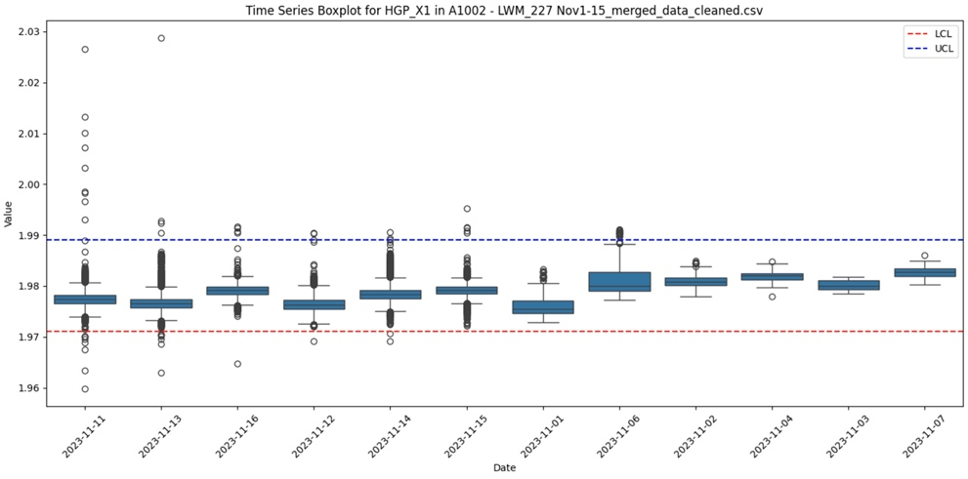
Methodology - TDK use case
Fig 19 – Datewise Histograms for Machine data
Fig 20 – Time series analysis for Machine data for all variables
Fig 18 – Datewise Boxplots for Machine data
Visualization techniques generated boxplots and histograms using python libraries.
Implemented KNN imputation to fill in missing values using neighbours 5 and 10.

Slide 16
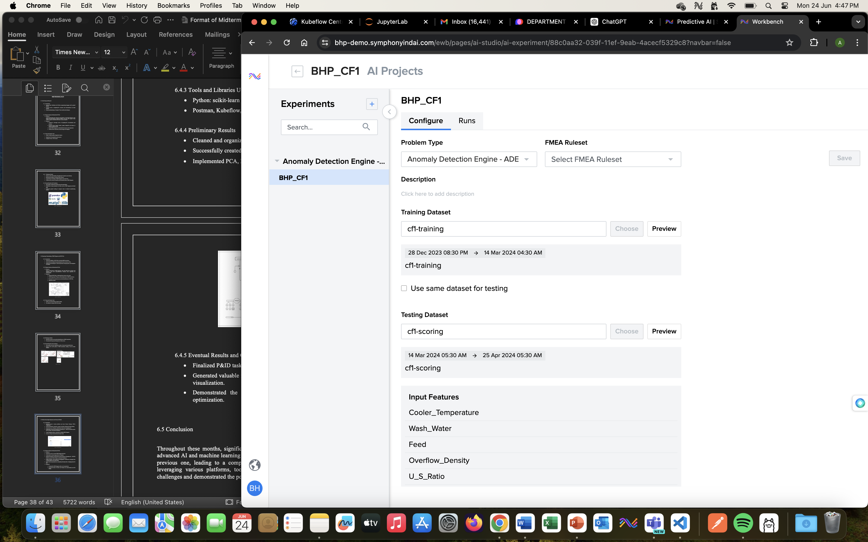
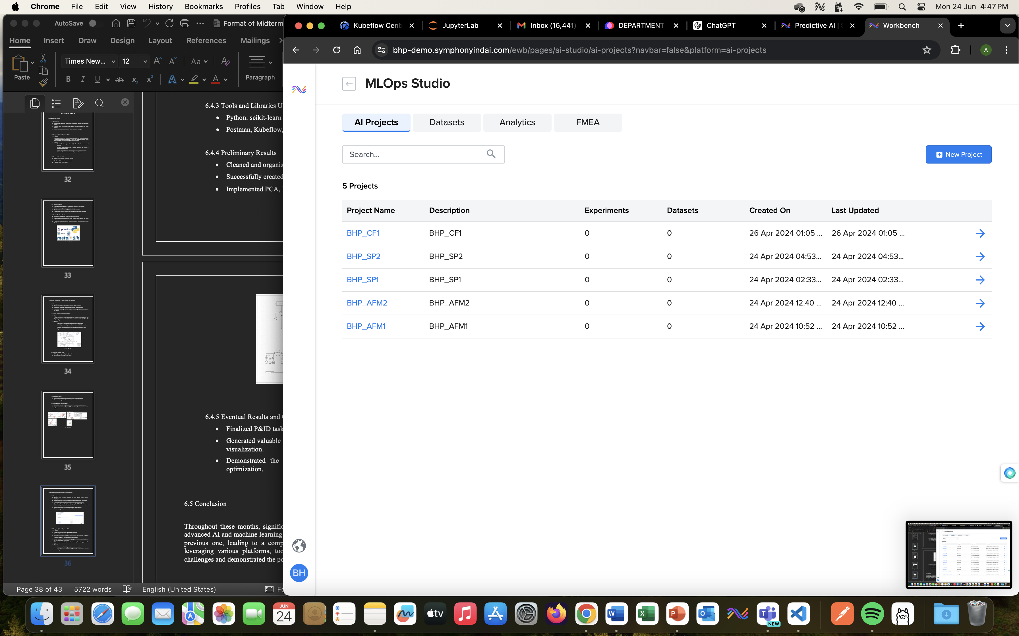
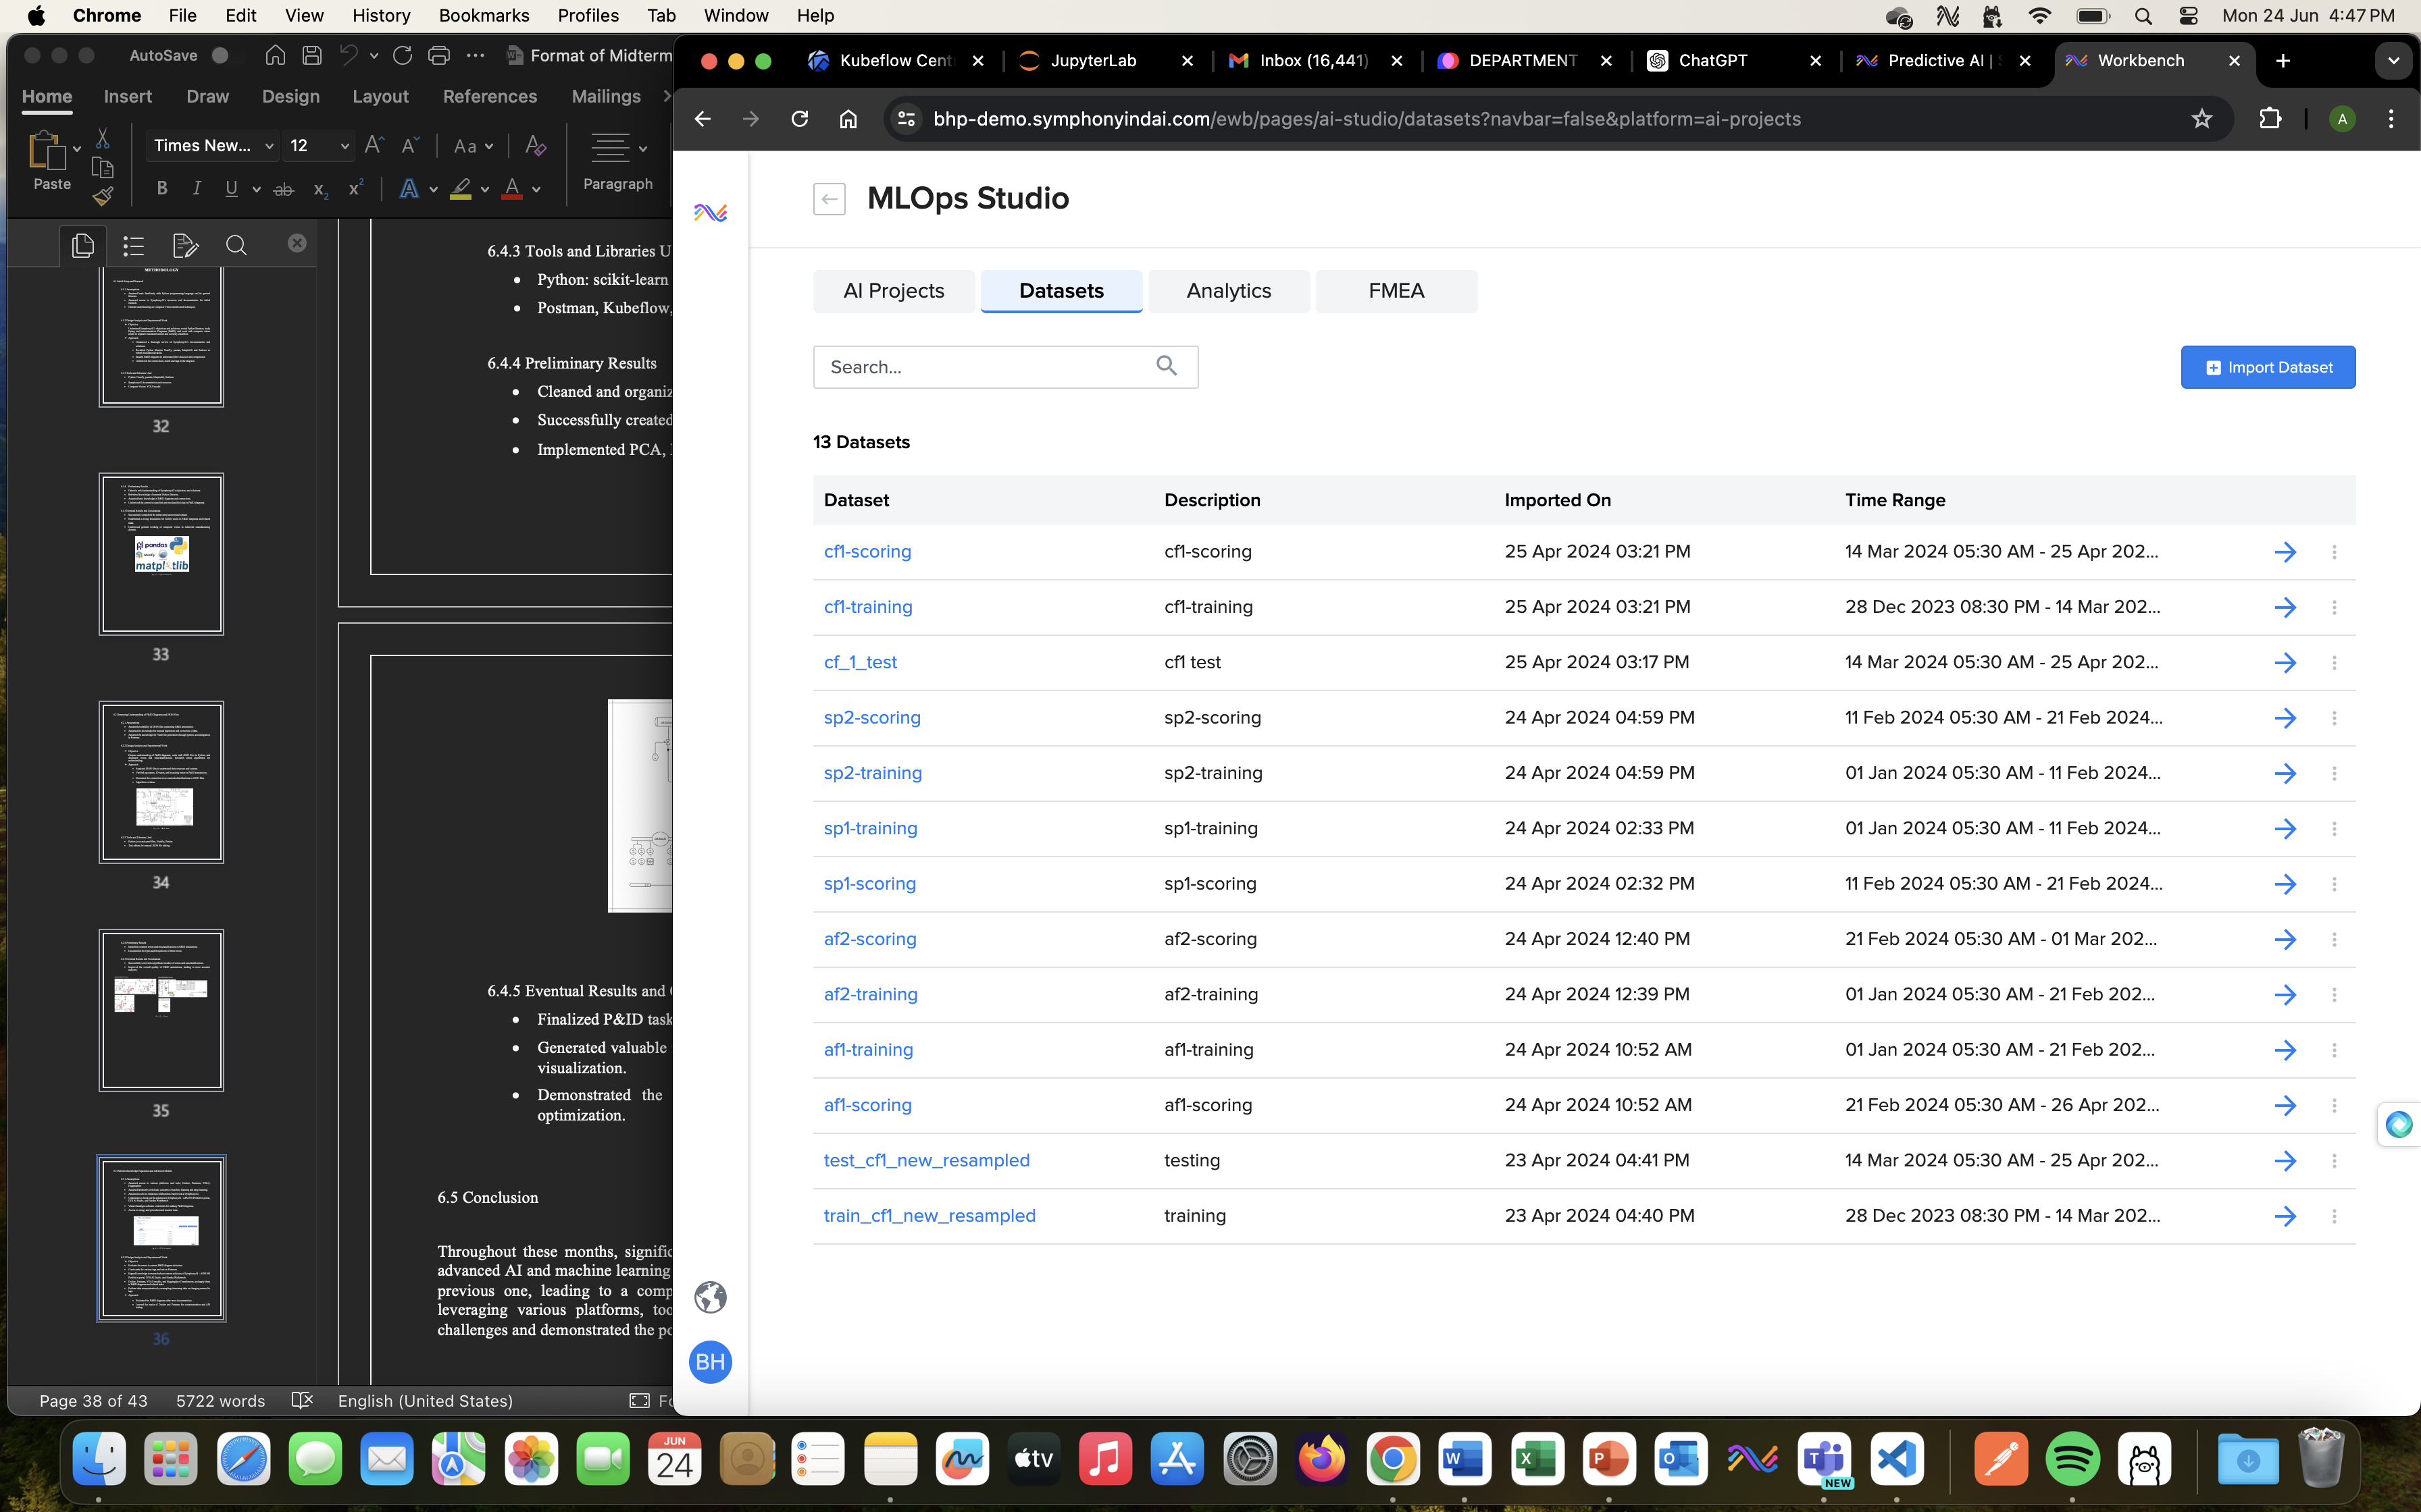
Methodology - CF use case
Fig 21 – MLOps Studio platform for new project creation
Fig 22 – Perform Anomaly analysis
Data cleaning - Resampling of data available
Conducted detailed data analysis to identify patterns and anomalies.
Fig 23 – Add the datasets

Slide 17
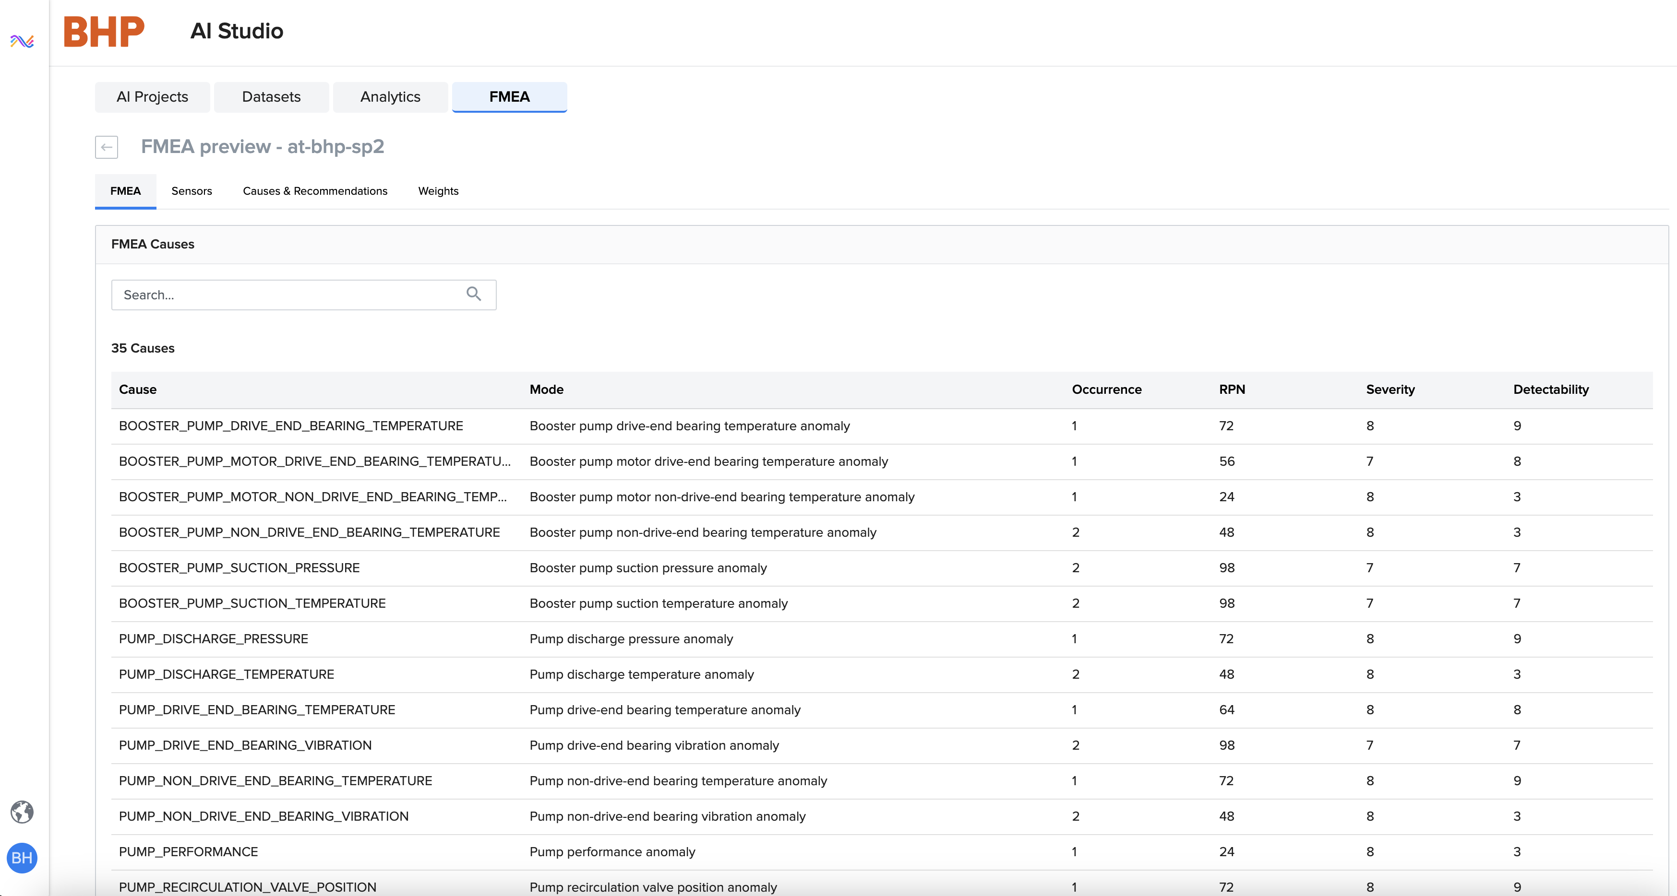
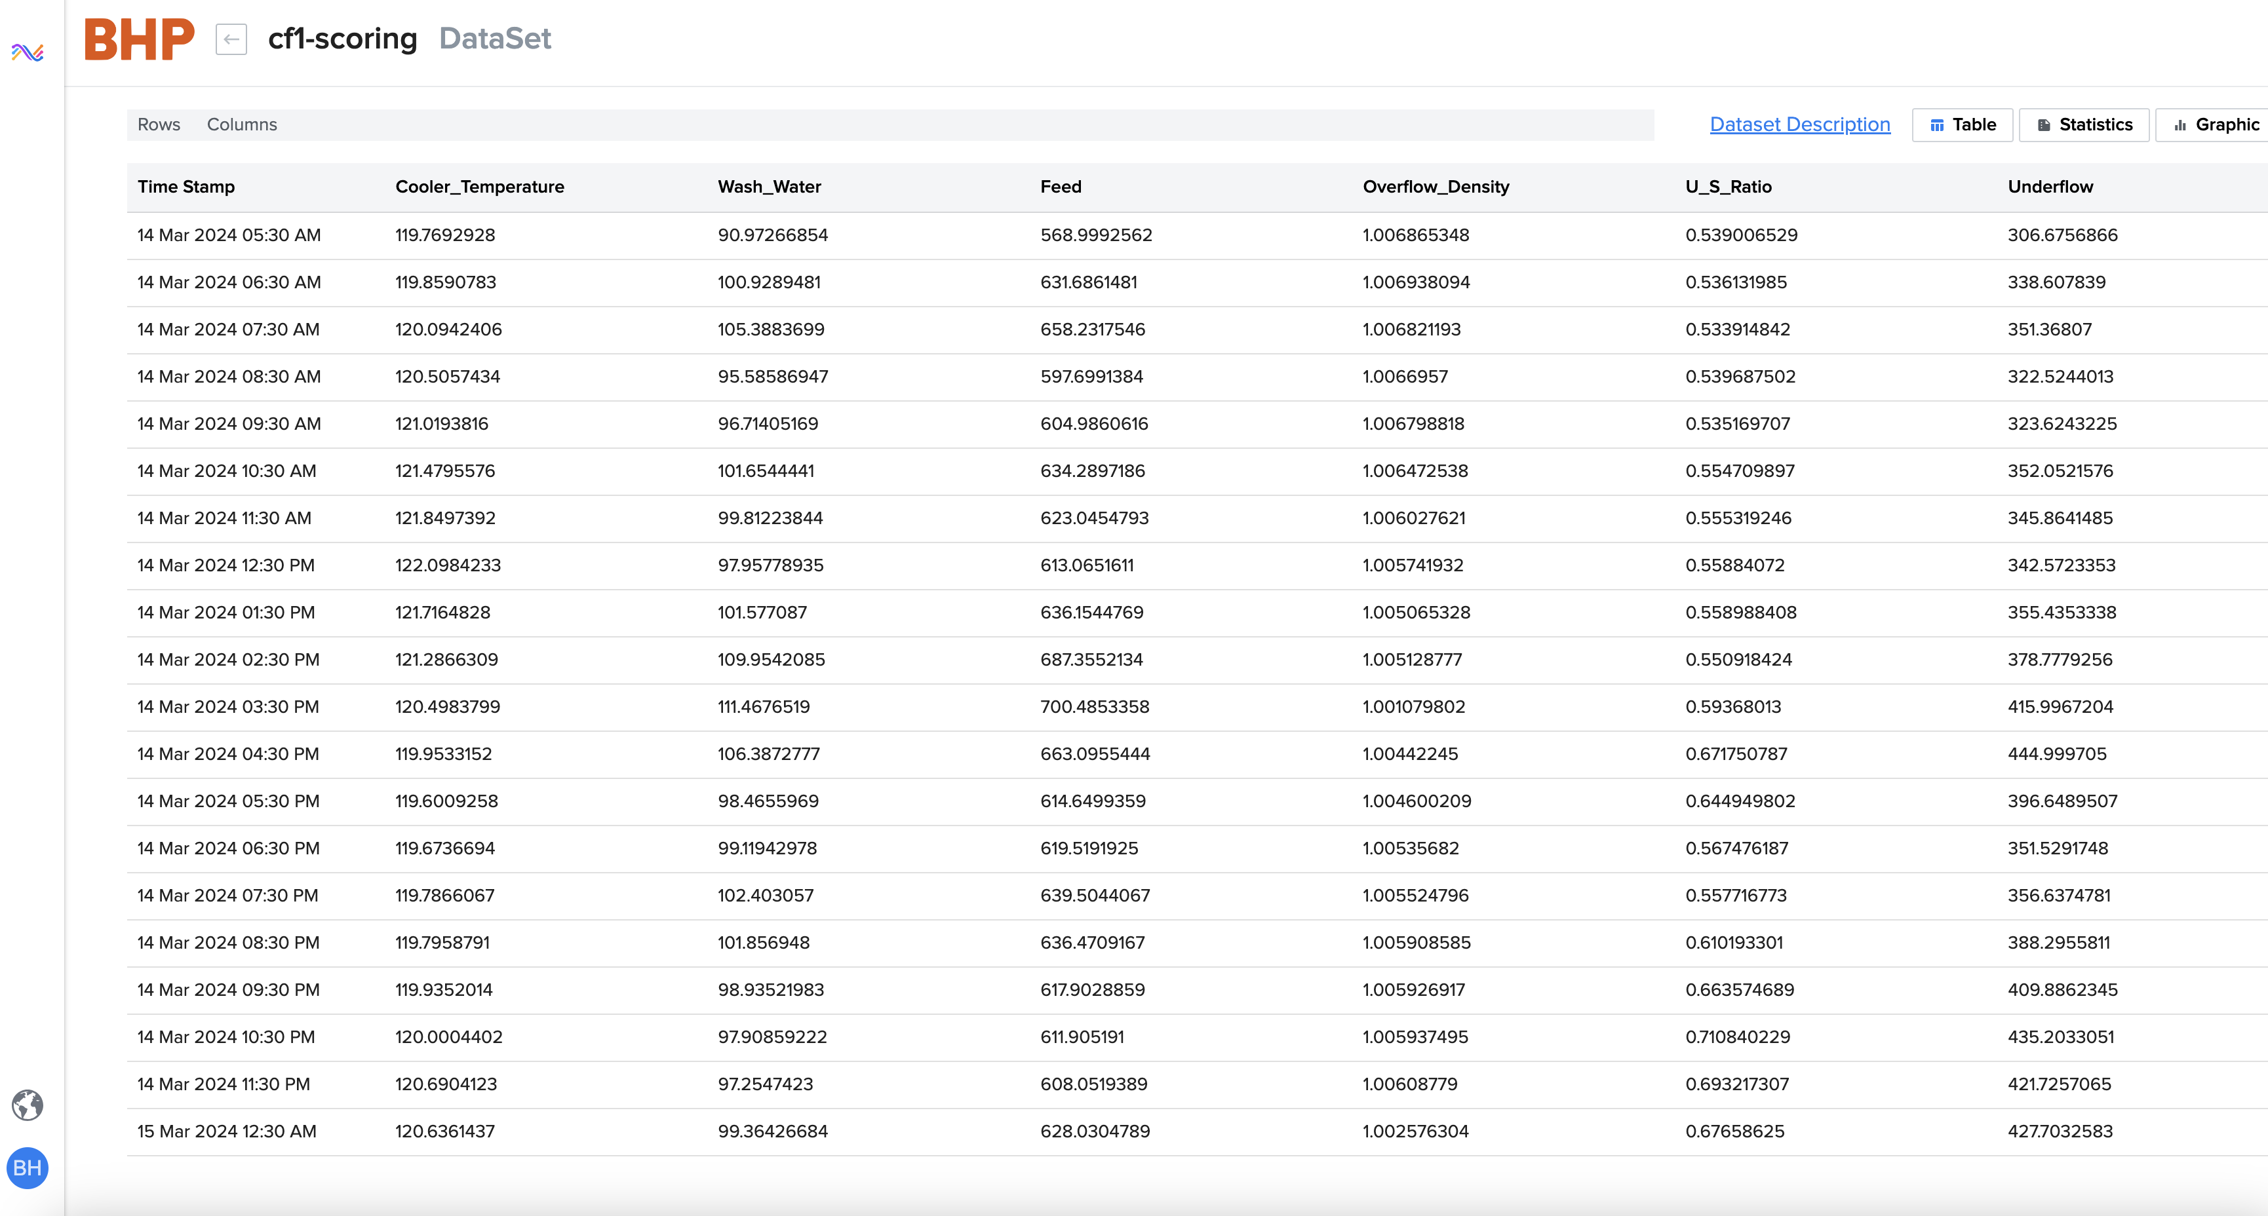
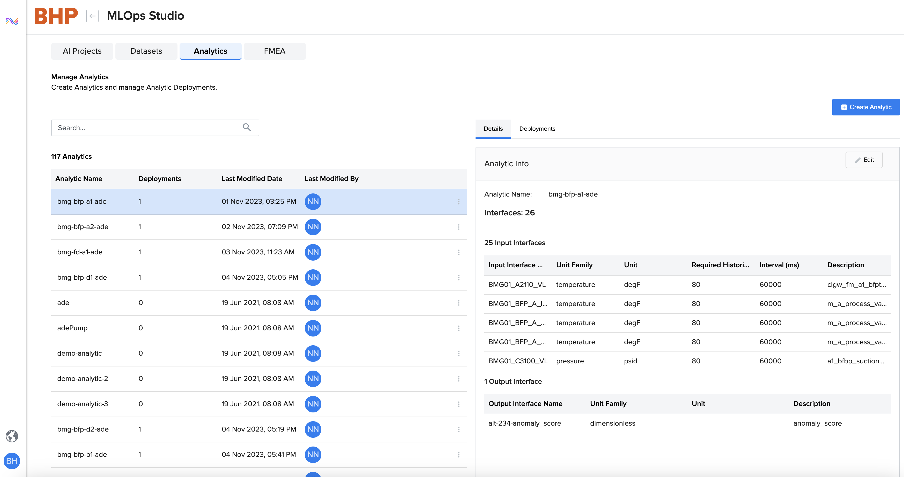
METHODOLOGY - CF USE CASE
Fig 26 – FMEA analysis
Fig 24 – scoring data uploaded
Failure Mode and Effect Analysis (FMEA)
A systematic method for evaluating processes to identify potential failure points. This involves statistical analysis and risk assessment techniques.
Risk Priority Number (RPN)
RPN = Severity × Occurrence × Detection
Fig 25 – Analytics performed

Slide 18
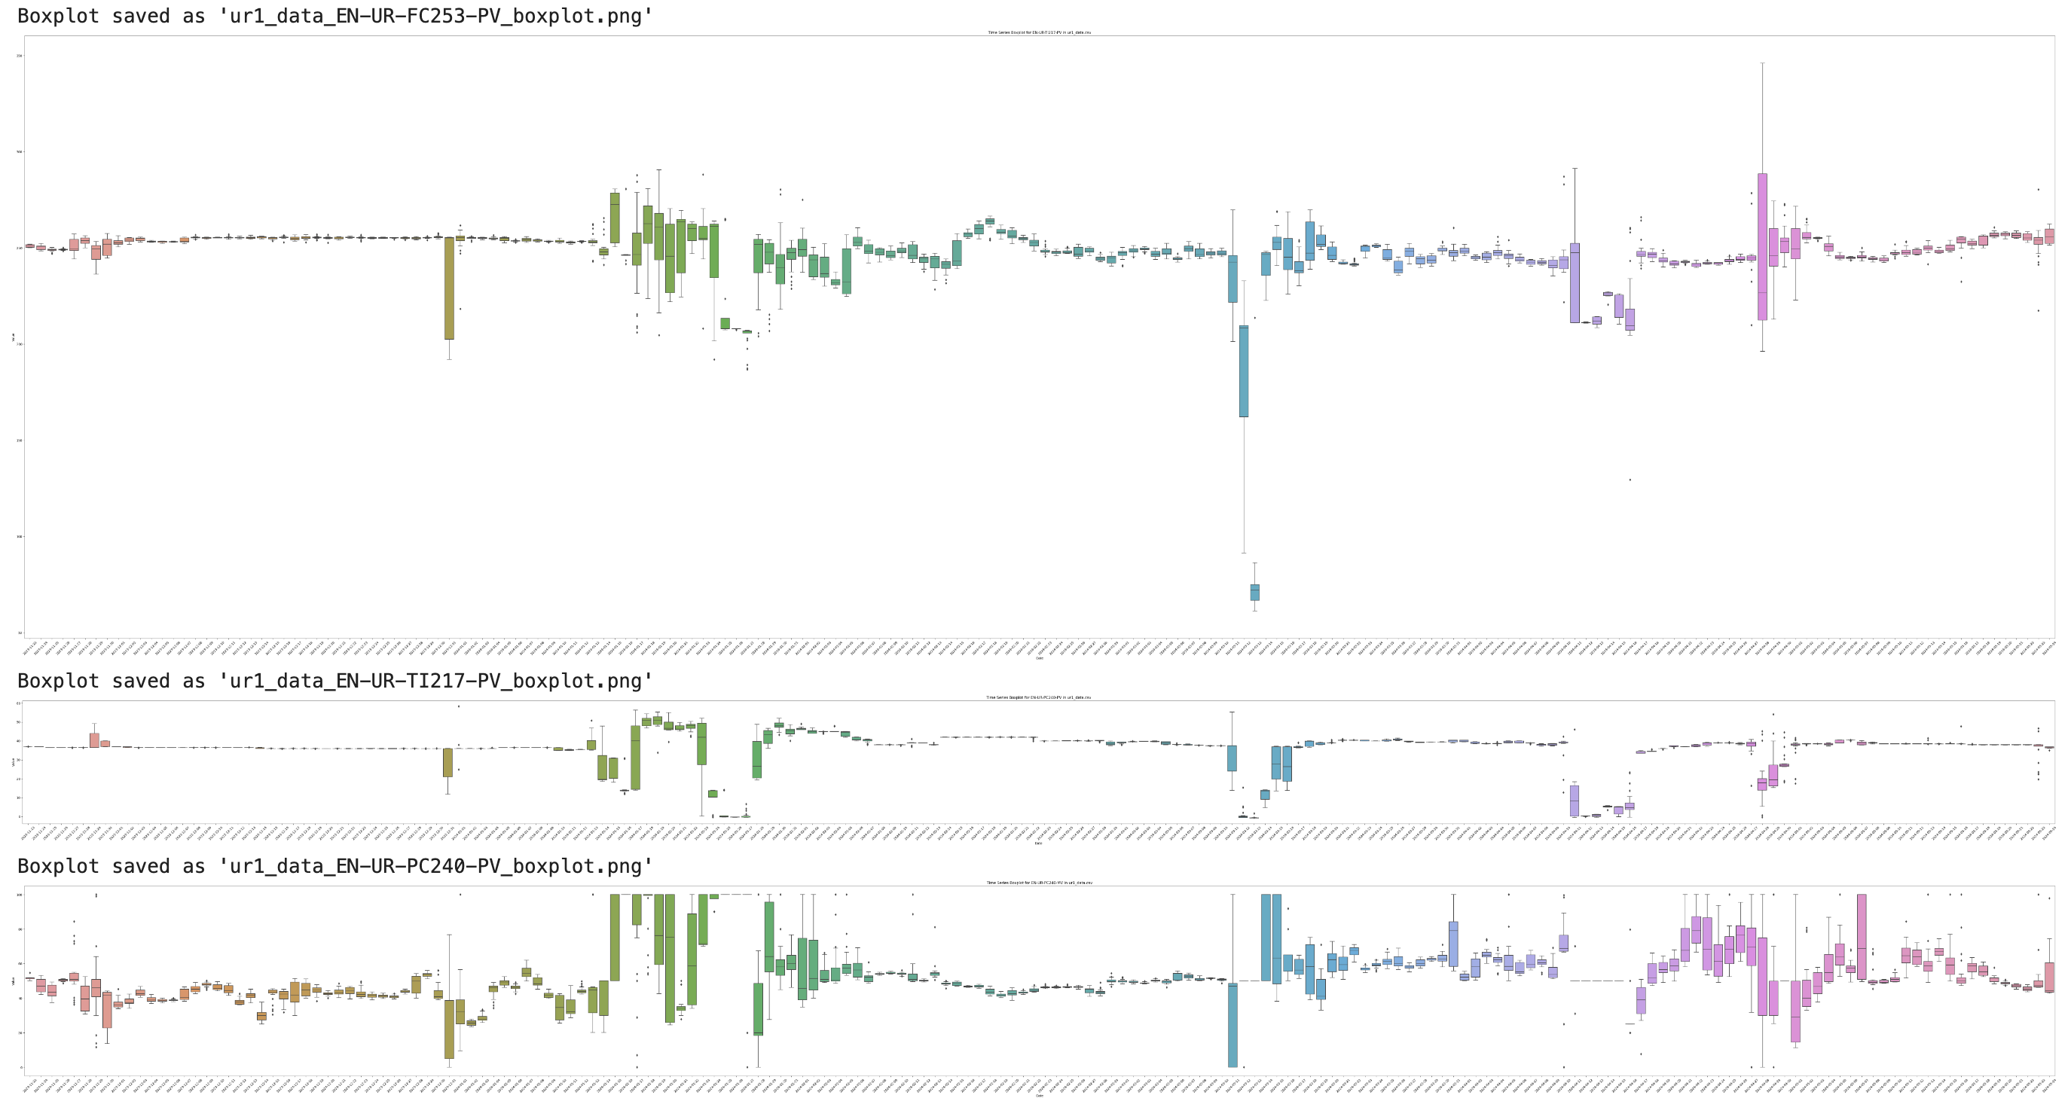
METHODOLOGY - ur USE CASE
Fig 26 – Time Series analysis
Cleaned and preprocessed data for analysis.
Filled merged cells by forward-filling merged cells filled NaN values and cleaned timestamp format to datetime.
Calculate key statistics and control limits to generate scatter plots of the variable over time.
Further, use the z-score (X-Mean/Standard Deviation) method to identify and remove outliers from the data and calculate the improved control limits.

Slide 19
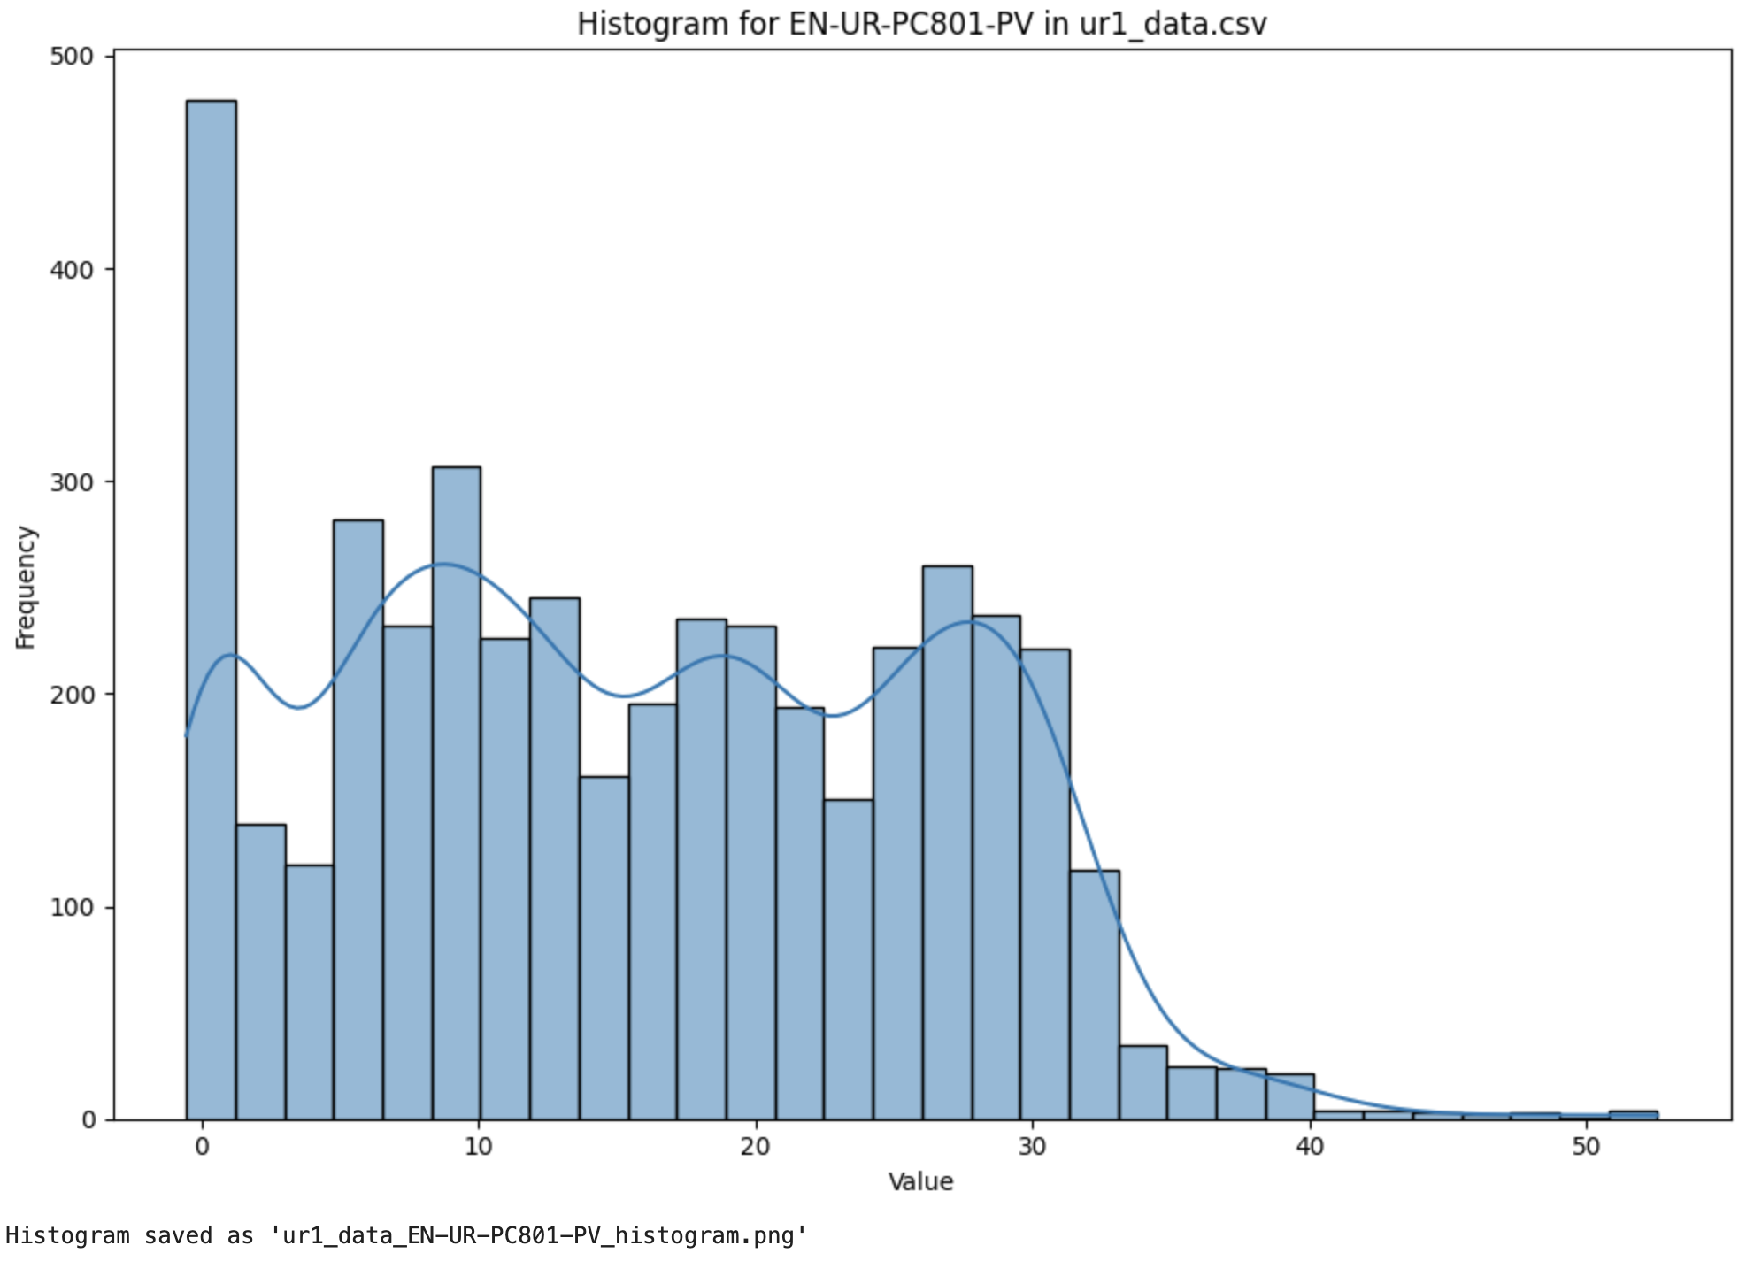
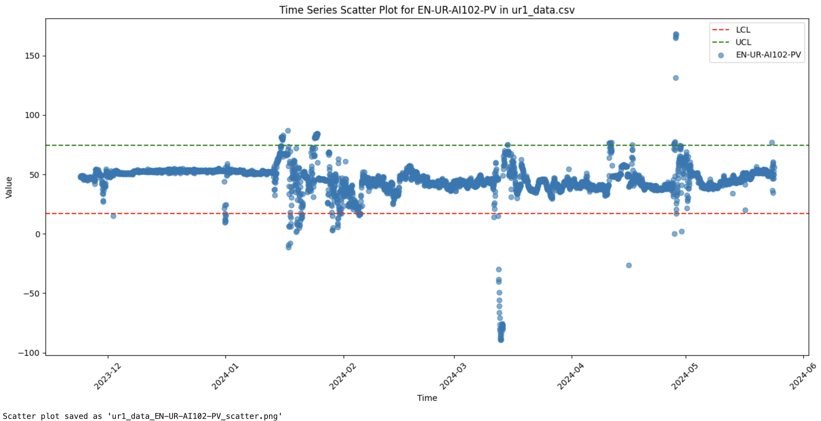
METHODOLOGY - ur USE CASE
Fig 26 – Scatterplots generated
Fig 26 – Histograms generated

Slide 20
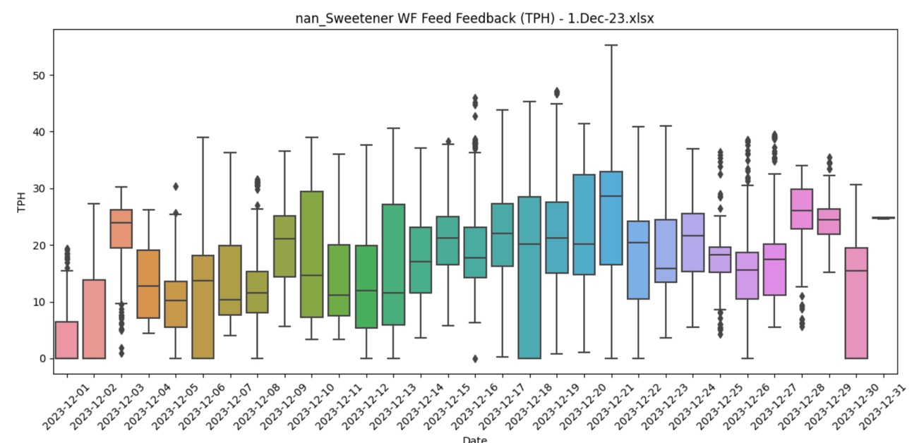
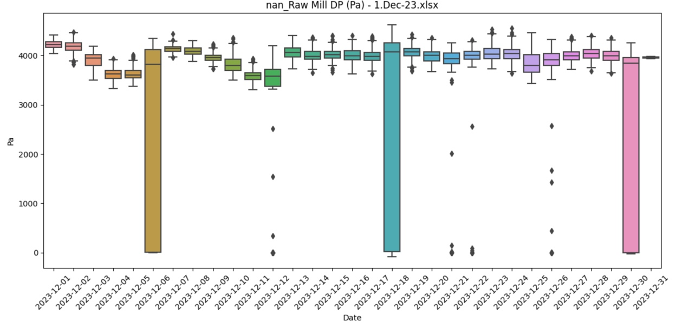
METHODOLOGY - Nuvoko USE CASE
Outlier detection by visualized analysis

Slide 21
RESULTS
Foundation and Progression
Technical Proficiency
Data Quality and Analysis
Collaboration and Systematic Approach
Enhanced technical proficiency of Postman.
Developed effective data anonymization strategies for confidentiality of tenant data.
Successfully expanded platform knowledge and tool proficiency.
Applied these tools and techniques to solve industry-specific problems.

Slide 22
FUTURE SCOPE
Aim is to utilize the platforms developed by SymphonyAI to harness the use of AI in industrial optimization. This can be in automating error handling for P&ID diagrams to prevent any humanized delay in generating the diagram.
Further, GenAI (Generative AI) and PredAI (Predictive AI) can revolutionize the industry by enhancing operational efficiency and drive in innovation in the industry.
Advanced predictive maintenance can enhance failure prediction and reduce wastage by real-time monitoring (predictive energy optimization).
GenAI can optimize product generation and procedure.
AI-assisted decision-making can help generating insights of complex industrial processes.
Adaptive learning systems can gradually take over routine tasks by learning from human operators.

Slide 23
ENVIRONMENTAL AND SUSTAINABILITY PROCEDURES
Perform anomaly detection to ensure anomaly detection is based on data collection issue and not on machinery failure.
SAFETY AND SECURITY PROCEDURES
Real-time monitoring and anomaly detection further contributed to reducing resource wastage and power by understanding and stopping the machinery in case of any immediate problem.
Safety and Security to maintain the confidentiality of data, and do not replicate the data inside or outside the work premises for any personal or financial gain.
Intellectual Property: Ensured all designs, software, and innovations developed during the project complied with SymphonyAI’s policies and respected third-party IP rights.
Ethical Dilemma of comparing client data of the same problem to come at a faster solution versus remaining confidentiality of individual data.

Slide 24
REFERENCES
KimrayInc, youtube.com/c/KimrayInc
Kimray, P&ID reference guide
Algorithm Design Theory, Geeks for Geeks
Developer tools in cloud, amazon web services
Huggingface transformers
Learning postman, docs overview
Anomaly Detection, IBM
FMEA analysis

